Slide 1
Chapter 18
Searching and Sorting Algorithms
© 2018 Cengage Learning. All Rights Reserved. May not be copied, scanned, or duplicated, in whole or in part, except for use as permitted in a license distributed with a certain product or service or otherwise on a password-protected website for classroom

Slide 2
Objectives
In this chapter, you will:
Learn about the various search algorithms
Explore how to implement the sequential search algorithm and how it performs
Explore how to implement the binary search algorithm and how it performs
Learn about the asymptotic notation, Big-O, used in algorithm analysis
Become familiar with the lower bound on comparison-based search algorithms
Learn about the various sorting algorithms

Slide 3
Introduction
Using a search algorithm, you can:
Determine whether a particular item is in a list
If the data is specially organized (for example, sorted), find the location in the list where a new item can be inserted
Find the location of an item to be deleted

Slide 4
Searching and Sorting Algorithms
Data can be organized with the help of an array or a linked list
unorderedLinkedList
unorderedArrayListType

Slide 5
Search Algorithms
Key of the item
Special member that uniquely identifies the item in the data set
Key comparison: comparing the key of the search item with the key of an item in the list
Can count the number of key comparisons

Slide 6
Sequential Search
Sequential search (linear search):
Same for both array-based and linked lists
Starts at first element and examines each element until a match is found
Our implementation uses an iterative approach
Can also be implemented with recursion

Slide 7
Sequential Search Analysis (1 of 2)
Statements before and after the loop are executed only once
Require very little computer time
Statements in the while loop repeated several times
Execution of the other statements in loop is directly related to outcome of key comparison
Speed of a computer does not affect the number of key comparisons required

Slide 8
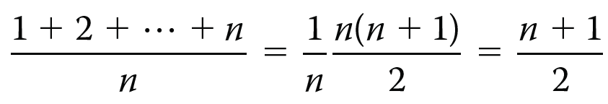
Sequential Search Analysis (2 of 2)
L: a list of length n
If search item (target) is not in the list: n comparisons
If the search item is in the list:
As first element of L → 1 comparison (best case)
As last element of L → n comparisons (worst case)
Average number of comparisons:

Slide 9
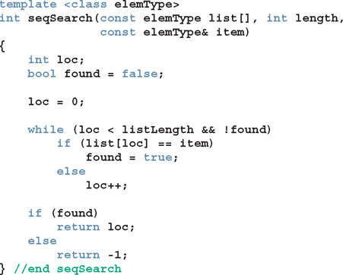

Slide 10
Sorting Algorithms
To compare the performance of commonly used sorting algorithms
Must provide some analysis of these algorithms
These sorting algorithms can be applied to either array-based lists or linked lists

Slide 11
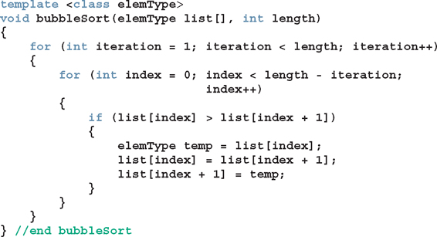
Sorting a List: Bubble Sort (1 of 3)
Suppose list[0]...list[n–1] is a list of n elements, indexed 0 to n–1
Bubble sort algorithm:
In a series of n-1 iterations, compare successive elements, list[index] and list[index+1]
If list[index] is greater than list[index+1], then swap them

Slide 12
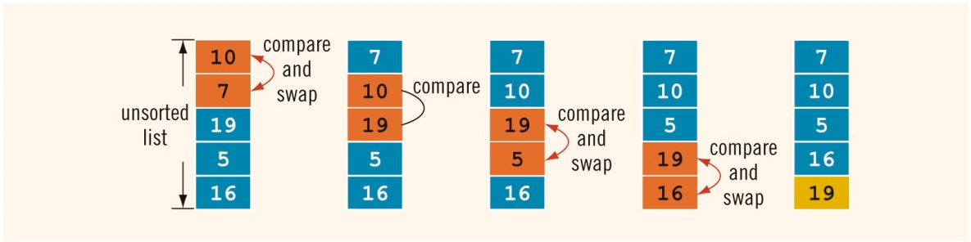
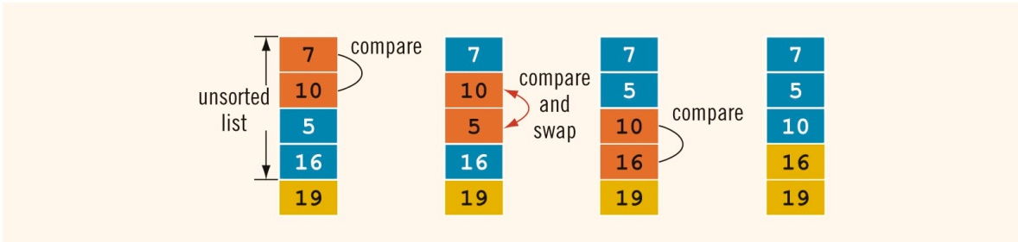
Sorting a List: Bubble Sort (2 of 3)
FIGURE 18-7 Elements of list during the first iteration
FIGURE 18-8 Elements of list during the second iteration

Slide 13


Sorting a List: Bubble Sort (3 of 3)
FIGURE 18-10 Elements of list during the fourth iteration
FIGURE 18-9 Elements of list during the third iteration

Slide 14
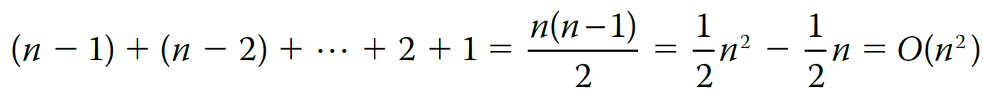
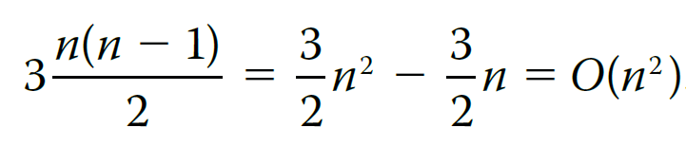
Analysis: Bubble Sort
bubbleSort contains nested loops
Outer loop executes n – 1 times
For each iteration of outer loop, inner loop executes a certain number of times
Total number of comparisons:
Number of assignments (worst case):

Slide 15
Binary Search (1 of 3)
Binary search can be applied to sorted lists
Uses the “divide and conquer” technique
Compare search item to middle element
If search item is less than middle element, restrict the search to the lower half of the list
Otherwise restrict the search to the upper half of the list

Slide 16

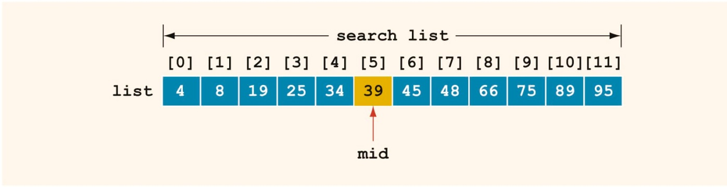
Binary Search (2 of 3)
FIGURE 18-1 List of length 12
FIGURE 18-2 Search list, list[0] . . . list[11]

Slide 17
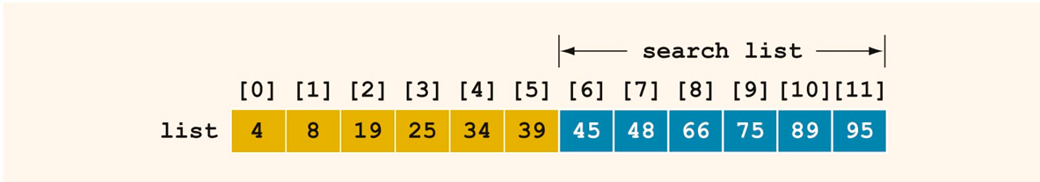
Binary Search (3 of 3)
Search for value of 75:
FIGURE 18-3 Search list, list[6]...list[11]

Slide 18
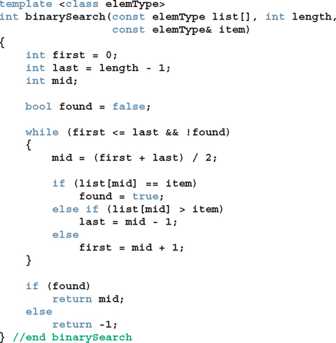

Performance of Binary Search
Every iteration cuts size of the search list in half
If list L has
At most 11 iterations needed to find x
Every iteration makes two key comparisons
In this case, at most 22 key comparisons
​
Sequential search required 512 key comparisons (average) to find if x is in L

Slide 19
Asymptotic Notation: Big-O Notation (1 of 8)
After an algorithm is designed, it should be analyzed
May be various ways to design a particular algorithm
Certain algorithms take very little computer time to execute
Others take a considerable amount of time

Slide 20
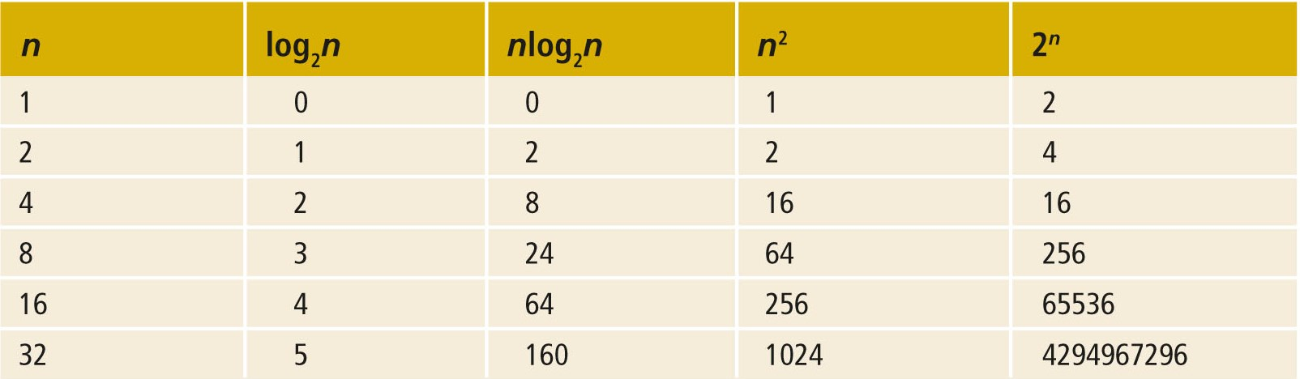
Asymptotic Notation: Big-O Notation (2 of 8)
TABLE 18-4 Growth Rate of Various Functions

Slide 21
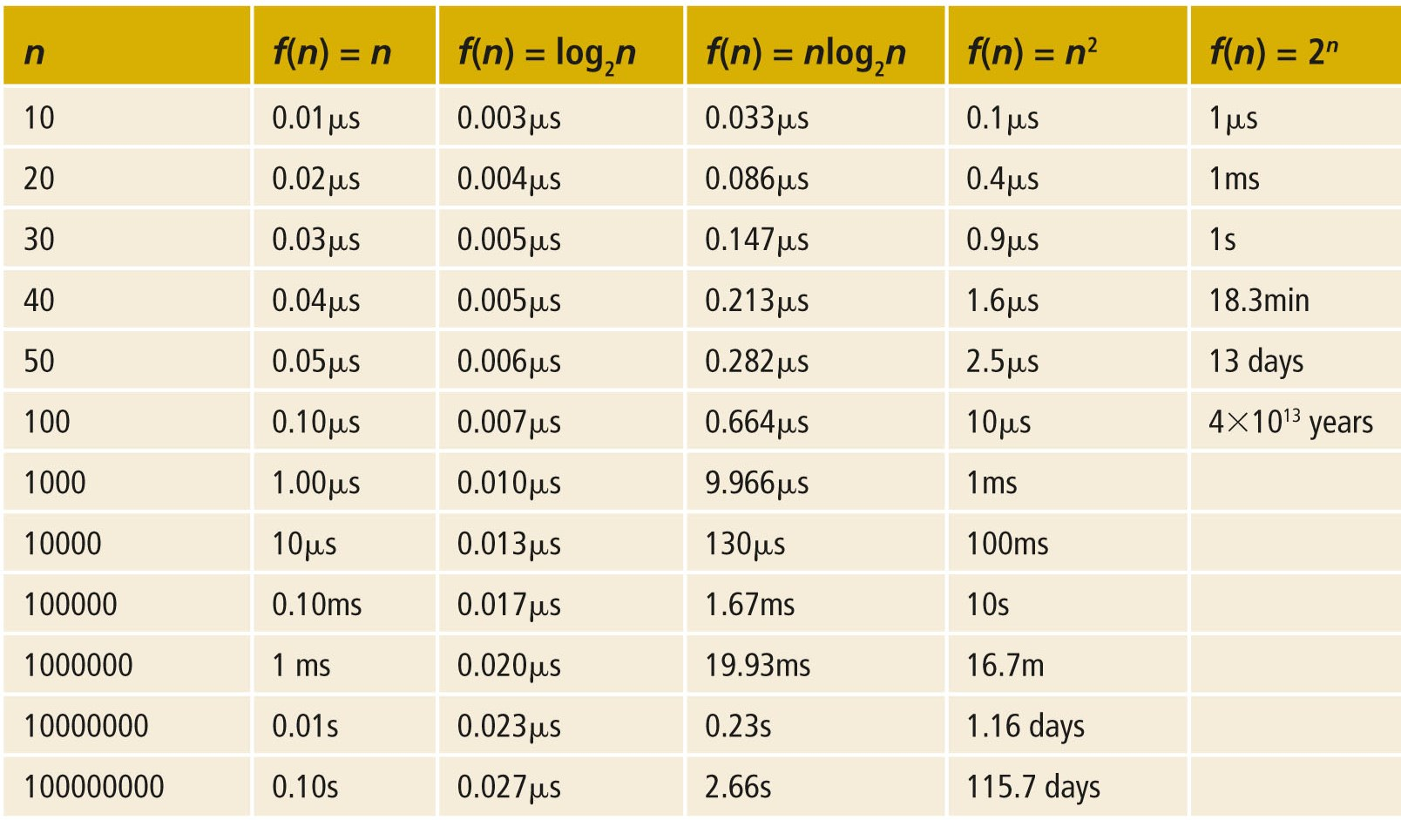
Asymptotic Notation: Big-O Notation (3 of 8)
TABLE 18-5 Time for f(n) Instructions on a Computer That Executes 1 Billion Instructions per Second

Slide 22
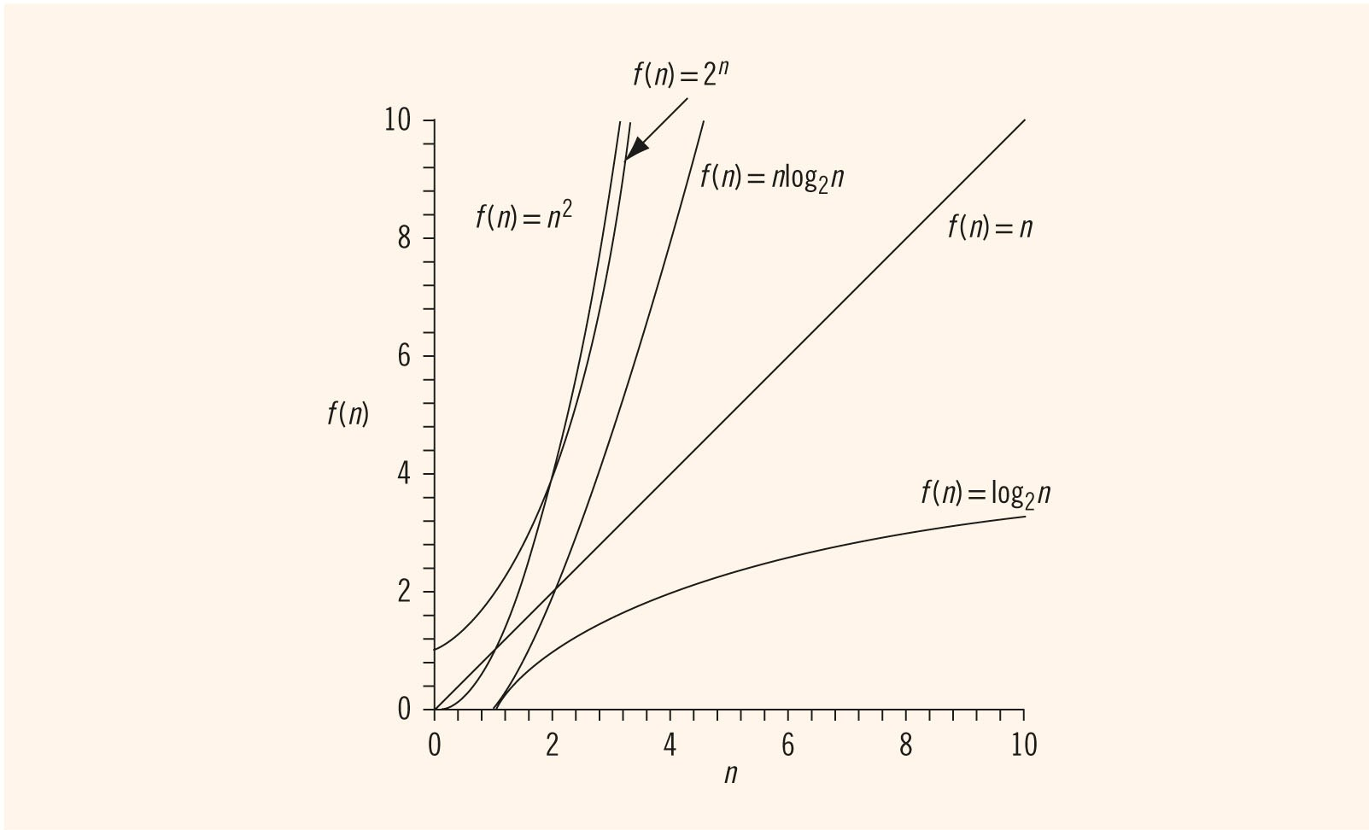
Asymptotic Notation: Big-O Notation (4 of 8)
FIGURE 18-5 Growth rate of various functions

Slide 23

Asymptotic Notation: Big-O Notation (5 of 8)
Let f be a function of n
Asymptotic: the study of the function f as n becomes larger and larger without bound
Let f and g be real-valued, non-negative functions
f(n) is Big-O of g(n), written f(n) = O(g(n)) if there are constants c and n₀ such that

Slide 24

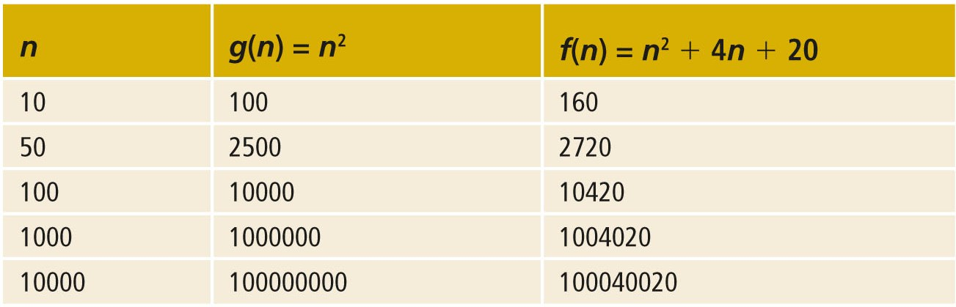
Asymptotic Notation: Big-O Notation (6 of 8)
TABLE 18-6 Growth Rate of

Slide 25
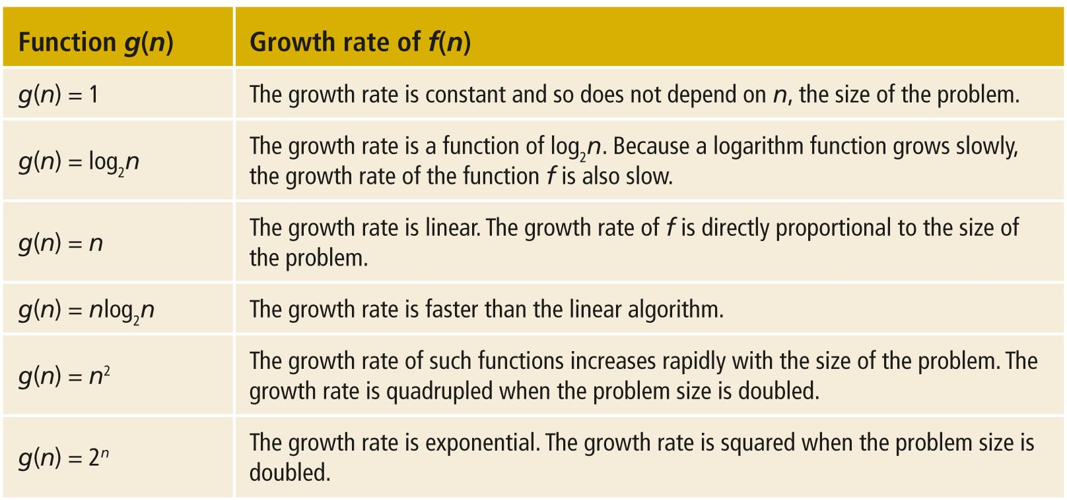
Asymptotic Notation: Big-O Notation (7 of 8)
TABLE 18-7 Some Big-O Functions That Appear in Algorithm Analysis

Slide 26
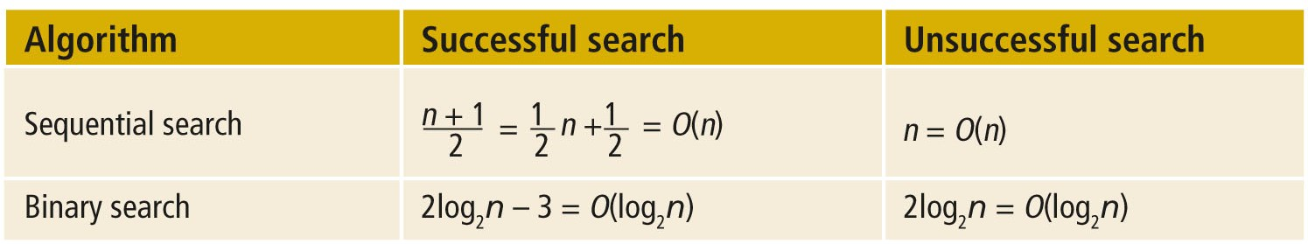
Asymptotic Notation: Big-O Notation (8 of 8)
We can use Big-O notation to compare sequential and binary search algorithms:
TABLE 18-8 Number of Comparisons for a List of Length n

Slide 27

Lower Bound on Comparison-Based Search Algorithms
Comparison-based search algorithms:
Search a list by comparing the target element with list elements
Theorem: Let L be a list of size n > 1. Suppose that the elements of L are sorted. If SRH(n) denotes the minimum number of comparisons needed, in the worst case, by using a comparison-based algorithm to recognize whether an element x is in L, then
Corollary: The binary search algorithm is an optimal worst-case algorithm for solving search problems by the comparison method.
From these results, it follows that if we want to design a search algorithm that is of an order less than log₂n, then it cannot be comparison based.

Slide 28
Summary (1 of 2)
On average, a sequential search searches half the list and makes O(n) comparisons
Not efficient for large lists
A binary search requires the list to be sorted
2log₂n − 3 key comparisons
Let f be a function of n: by asymptotic, we mean the study of the function f as n becomes larger and larger without bound

Slide 29

Summary (2 of 2)
Binary search algorithm is the optimal worst-case algorithm for solving search problems by using the comparison method
To construct a search algorithm of the order less than log₂ n, it cannot be comparison based
Bubble sort:
key comparisons and item assignments

